Slide 1

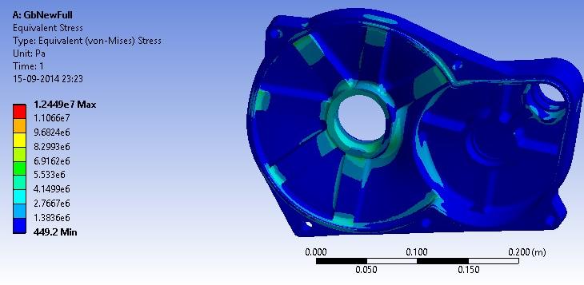
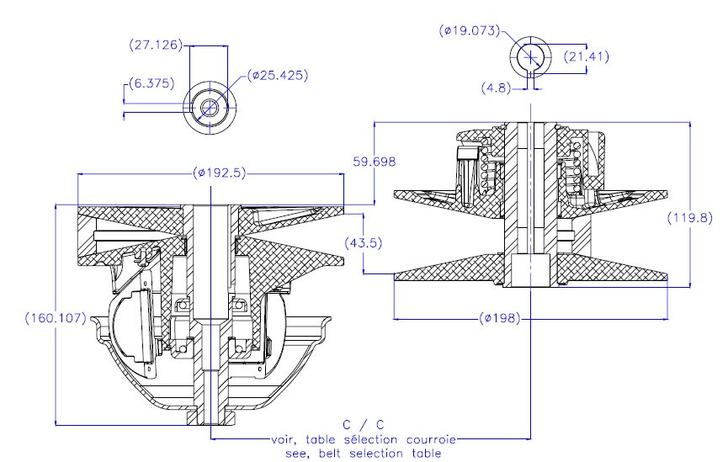
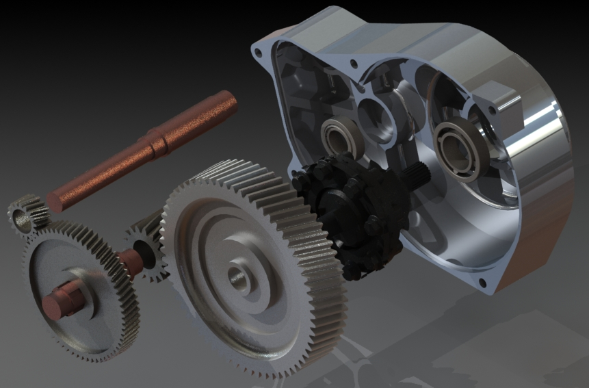
BE Project 2014 -15
Design and Analysis of the Drive Train of an All-Terrain Vehicle
Group No.
48
1. Priyank Metha 2. Rohit Salgaonkar 3.Soham Gokhale
Guide: Prof. V S Narawne
Abstract
Drivetrain basically concerns with conveying power from the vehicle’s engine, through the transmission to the drive wheels on the vehicle to control the amount of torque. It comprises of the Engine, CVT, Gearbox, Differential, CV joints and Axle shafts. The ATVs are meant for operation on rough, off-road terrains which demand higher torque and a smooth transmission. An automatic transmission system through the use of a CVT has been incorporated due to its advantage of having smooth operation (infinite gear ratios) and compactness over manual transmission. Also CVT tuning enables us to operate the engine at power peak so that power is transmitted most efficiently. A self-designed two stage reduction gearbox is coupled with the CVT to achieve the desired torques requirements for the terrain. An open differential is integrated with the gear train to provide aid in steering. While designing and analysis emphasis is laid on, material selection, selection of proper FOS, method of production for gears and the gearbox so as to ensure longer life for the system, minimal transmission losses and also minimize the total cost of the system so that it can compete in the existing market. Also proper system layout has been ensured for ease in serviceability.
Literature Review
Clutch Tuning:
Engagement speed: The engagement speed of the CVT is determined by the driver pressure spring and the flyweights.
Shift speed: The shift speed is the speed of the engine where the velocity ratio shifts from the lower ratio to the higher ratio. It is determined by the driver settings and the torsion spring and ramp angles on the driven.
The CVT should be tuned such that the engine runs in the power peak range under its entire range of operation. This can be achieved by varying the parameters like the spring constant, spring pretension, torsional stiffness of the spring, flyweight masses and ramp angle.
Gearbox:
For a reduction ratio of above 4, a multiple stage compound gear train is recommended. A two stage drive train is suited for the reduction ratio of about 14, with about 3.7 reduction ratio at each stage. Helical gears perform well in high speed operations where smooth transmission and low noise is essential. Helical gears are therefore suited for vehicle gear box systems. Full depth involute system is the most commonly used system for the gear profile suited for high speed transmissions.
Uniform teeth profile, load application on a single tooth at a time, neglecting the radial and compressive forces, are some of the assumptions made during the gear calculations. To account for the neglected factors, a suitable factor of safety of 2.5 is selected for the selection of the modules.
Selection of bearings is based on the factors like axial loads, radial loads, average speed of operation and life of the bearing.
Shaft design is based on the torsional equations. Length of shaft is determined considering limited elastic deformation during operation.
The housing design constitutes space for the gears, and seats for the bearings. The casing should sustain forces like weight of the gears, radial and axial reactions of the bearings, and any outside impact to protect the components from damage. Housing design is based on basic principles of Machine Design and accepted theories of failure in tensile, bending and shear modes.
Material Selection:
Materials are selected based on their properties, availability, cost and suitability for the required application. Some examples of properties considered for material selection are yield strength, ultimate tensile strength, hardness, ability for heat treatment, machinability, allowable working temperature.
Methodology/ Research work
Study of the current design. Analysis of its drawbacks and plus points.
Plotting of the necessary improvements/changes.
Market research for materials, manufacturing processes, cost requirements.
Finalizing the project plan and cost estimation.
Theoretical calculations and CAD.
Analysis of component designs, finalizing of designs.
Manufacturing processes, purchase of supplemental parts.
Assembly of the components.
Testing of the assembly.
Experimentation and measurement of performance parameters.
CVT tuning.
Engine vibrational analysis.
Our current research work has three main subdivisions:
Design and analysis of components including the gears, rear axle, housing, etc.
Study of performance characteristics of the CVT and parameters that determine them. Study of CVT tuning and implementation.
Study of Vibrational analysis of an engine. Experimental analysis of the current engine and suitable damping and mounting of the engine.
For the reduction gearbox, the following research work has being undertaken:
Gear design and material selection. Gear manufacturing processes, their reliability, cost optimization. Hardening processes.
Housing design. Materials properties required for sand casting. Design considerations for sand casting. Determination of tolerances for bearing seats, shaft designs. CNC machining for critical sections.
Bearing and oil seals selection.
System layout considerations for proper serviceability.
FEA method for structural analysis.
For CVT systems:
Understanding the working of the CVT systems. Forces and basic physics of the working.
Study and determination of working parameters such as engagement RPM, shift RPM, etc.
Components determining parameters for design such as properties of springs, torsional springs, flyweight design and manufacture, ramp angles for shift, etc.
Modification of existing system through reverse engineering for suitable performance.
Engine Mounting:
Study of Vibrational analysis and vibration damping.
Experimentation for vibration characteristics of the engine.
Selection of suitable damping supports for reduction in transmitted vibrations.
Nodal Analysis using ANSYS.
Introduction
Our project focuses on the study, design, analysis and manufacturing of the power transmission system of the BAJA all-terrain vehicle in association with team Redshift Racing. The project encompasses the study of the previous gearbox designs of the team, the Continuously Variable Transmission System (CVT), and the development of a new design for a better performance of the vehicle.
We focus on the optimization of the current design in terms of the cost of manufacture and the overall weight of the system, along with the improvement in the performance characteristics like acceleration, maneuverability and speed. We design the components on CATIA software while carrying out structural analysis on ANSYS software. The project involves the design of the entire two stage reduction gearbox, study of the performance characteristics of the CVT and its suitable modification with rigorous testing, design and manufacture of the rear-axle, and stability and mounting considerations of the entire system in particular.
The system we design has applications in other fields like agriculture, snow-mobiles, and ATV sports. CVT systems are an emerging trend in today’s automobile industry. Due to its low cost, adaptability and compact assembly, CVT systems are suitable for applications in tractors and other agricultural equipment. The system we design implementing the CVT with low cost components such as the Briggs and Stratton Engine and gearbox considering mass production, is suited for these applications. Since it eliminates the use of a clutch and the need to switch gears, we believe it will revolutionize the industry in terms of such application in the near future.
Results and Conclusion
Through the study of previous designs, we came to the conclusion that the implementation of a differential is imperative, for the required maneuverability.
Material research and property wise analysis helped us select Lm-6 series aluminum for the gearbox housing and EN-24 and EN-36 series for the gears.
Through revised designs, we have achieved an FOS of a minimum of 6.64 at maximum stressed section.
Permutations for CVT engagement and shift speed calculations provided us optimum values for the tuning parameters like flyweight values, spring loading and stiffness.
After rigorous testing and enduring for about 70kms run, the entire transmission system is performing consistently with satisfactory results.
It has sustained all types of rough and inclined gradients successfully.
References
1. Design of Machine Elements – V. B. Bhandari, Tata McGraw-Hill Education, 2007.
2. Mechanical Engineering Design - J. E. Shigley, C. R. Mischke, R. G. Budynas, McGraw-Hill Series in Mechanical Engineering, 7th edition.
3. Clutch Tuning Handbook- Olav Aeen.
4. Design Data Book- Compiled by PSG College of Engineering.
5. SKF Bearing Catalogue.
6. Fundamentals of Mechanical Vibrations - S. Graham Kelly, McGraw-Hill Series in Mechanical Engineering, December, 1992.
7. Internal Combustion Engines – V. Ganesan, McGraw-Hill Series in Mechanical Engineering, August 1, 1995.
8. A first course in finite element method (3rdEdition) - Daryl L. Logan. Brooks/Cole, 2002.
9. ANSYS Tutorial - K.L. Lawrence. SDC Publications, 2003.

